Slide 1

ANALYSIS OF DEEP LEARNING ARCHITECTURES FOR ACCURATE COVID-19 DETECTION FROM CT SCAN IMAGES
EE 363 MACHINE LEARNING PROJECT
National Institute of Technology Andhra Pradesh
Supervised by : Dr. K. PHANI KRISHNA
Presented By:
MARUTHI MAHESH UPPALAMARTHI (521250)
S MANJU SAI (521229)
S YAMINI (521237)
O BLESSY (521206)

Slide 2
Literature Review
TITLE AND JOURNAL OF THE PAPER | ALGORITHM | PROS AND CONS
COVID-19 detection on Chest X-ray images: A comparison of CNN architectures and ensembles | DENSENET VGG MOBILENET RESNET | Achieved an accuracy of 99 percent on Chest X-ray images. CT Scan Images can give more detail than Chest X-ray images.
CNN supported automated recognition of Covid-19 infection in chest X-ray images | RESNET50 VGG RESNET18 | Achieved F1_score of 96 on chest X-ray images. Accuracy can be obtained more with modern architectures
COVID-19 detection using X-ray images and statistical measurements | EFFICIENTNETB1 XCEPTION NASNETMOBILE | Obtained an accuracy of 93 percent for image classification using ML Deep Learning Algorithms can perform efficiently.

Slide 3
Problem Statement
Addressing the Challenge of Efficiently Classifying COVID-19 Infections from CT Scan Images Using Optimized CNN Architectures to Minimize Human Error and Cost. The challenge is to classify the CT Scan Images rather than Chest X-Ray Images which are more efficient in finding the patterns of the Covid-19 infection.

Slide 4
Objectives
Develop and optimize Convolutional Neural Network (CNN) architectures tailored specifically for COVID-19 classification from CT scan images.
Explore and implement state-of-the-art deep learning techniques to enhance the accuracy and efficiency of CT scan image analysis for COVID-19 detection.
Conduct comprehensive performance evaluations and comparisons of different CNN architectures to determine the most effective model for accurate COVID-19 classification from CT scans.
Document and disseminate the findings, methodologies, and best practices discovered throughout the project to contribute to the broader research community and advance the field of medical image analysis for COVID-19 diagnosis.

Slide 5
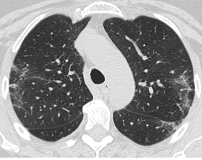
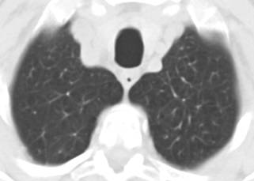
CT SCAN IMAGES :
COVID 19 | NON-COVID 19
DATASET :
The dataset used in this project is taken from Kaggle .
SARS-COV-2-Ct Scan Dataset
A total of 1252 CT Scans that are positive for COVID-19
A total of 1230 CT Scans of patients which are unaffected from COVID-19

Slide 6
METHODOLOGY
Convolutional Neural Networks (CNNs) excel at automatically learning hierarchical features from input images. Through convolutional layers, filters are applied across the input image, capturing low-level features like edges and textures, and gradually progressing to higher-level features such as shapes and objects.
CNNs leverage parameter sharing, where the same set of weights (or filters) is used across different spatial locations in the input image. This sharing reduces the number of parameters compared to fully connected networks, making CNNs more computationally efficient and easier to train.
CNNs apply convolutional operations followed by non-linear activation functions, such as ReLU (Rectified Linear Unit), to capture complex patterns and relationships within images. The non-linear activation function introduces non-linearity into the network, enabling it to learn and represent complex decision boundaries between different classes in the image classification task.

Slide 7
Algorithms for training the Deep Learning Model:
VGG16 ARCHITECTURE
ALEXNET ARCHITECTURE
LENET ARCHITECTURE
Evaluation metrics for Deep Learning Model:
Accuracy Score
Recall
Precision

Slide 8
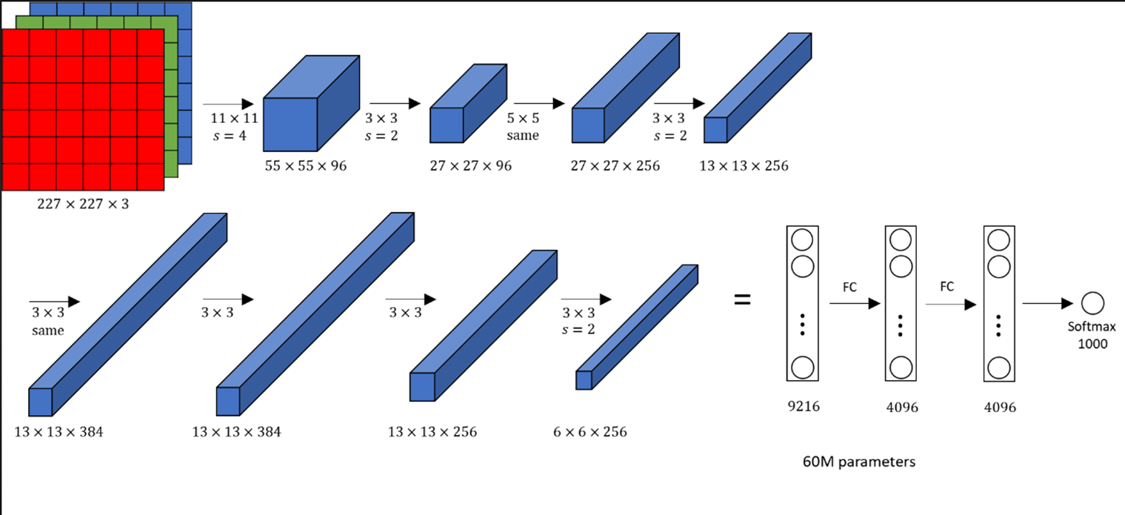
ALEXNET ARCHITECTURE :

Slide 9
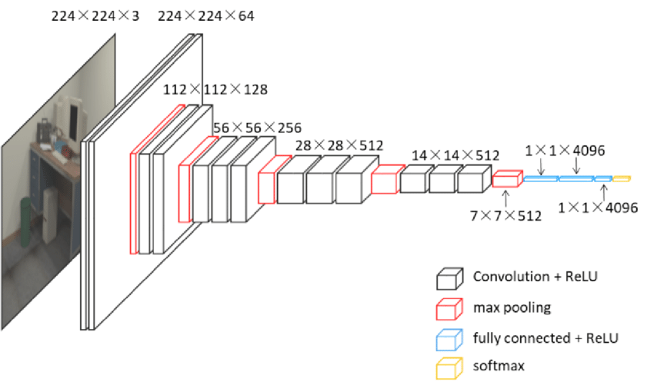
VGG16 ARCHITECTURE :

Slide 10
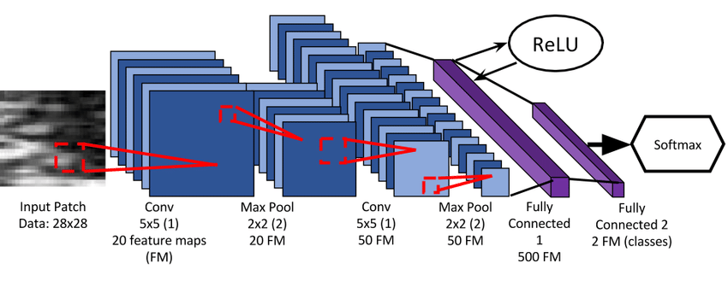
LENET ARCHITECTURE :

Slide 11
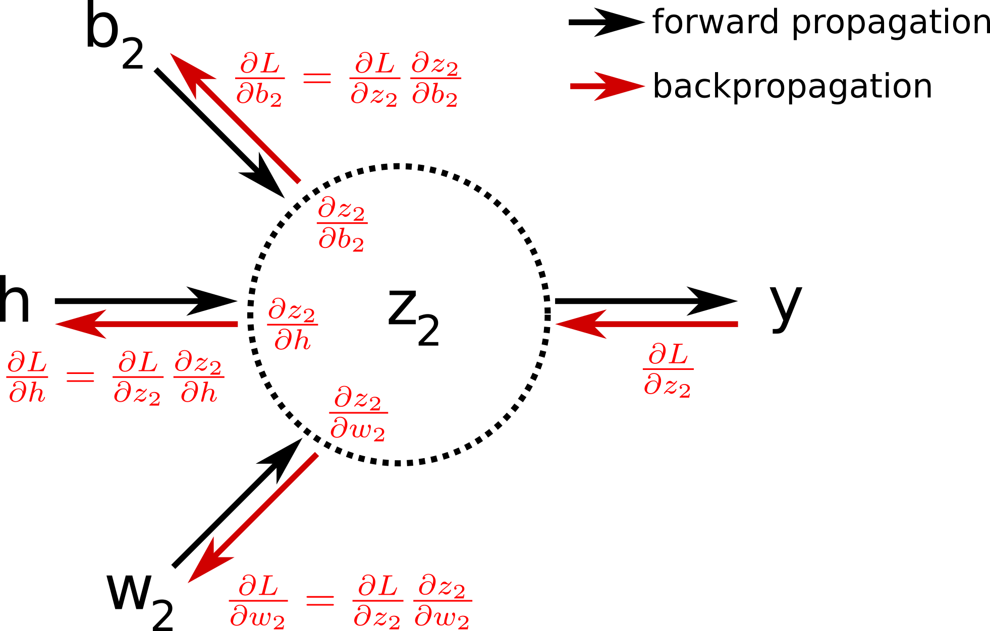
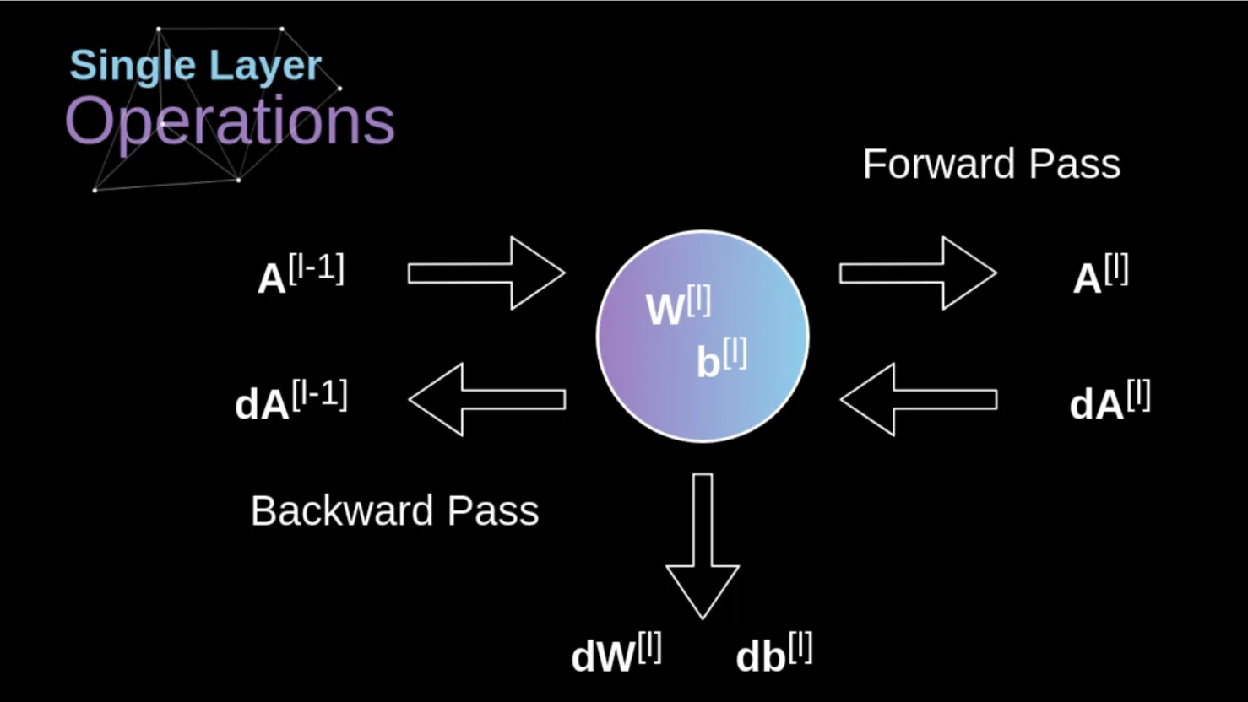
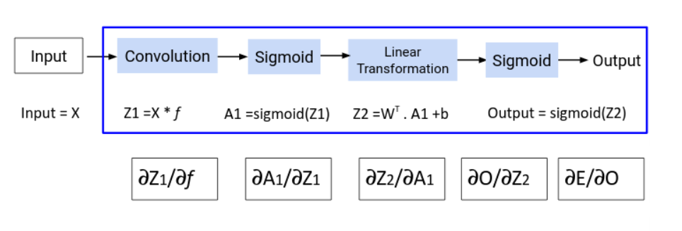
OUTPUT OF CONVOLUTIONAL LAYER :

Slide 12
SOFTWARE USED :
In this project we are using python jupyter notebook to run the codes and we are also using TensorFlow and PyTorch data frameworks.
Some of the parameters used in the deep learning modelling are listed below.
PARAMETER | DESCRIPTION
Model Architecture | Structure of the neural network including types of layers, activation functions, and regularization techniques.
Hyperparameters | Parameters set prior to training, including learning rate, batch size, number of epochs, optimizer choice, dropout rate, and weight decay.
Input Data Preprocessing | Parameters related to data preprocessing steps such as resizing, normalization, data augmentation, and handling missing values or outliers.
Training Configuration | Parameters related to the training process such as loss function, metrics, early stopping criteria, and callbacks.
Hardware Acceleration | Parameters related to utilizing hardware acceleration if available, including batch size adjustments, memory management, and GPU-specific configurations.
Evaluation Parameters | Parameters used during model evaluation, such as evaluation metrics and any additional evaluation settings.
Validation and Testing Parameters | Percentage of splitting the dataset into training set, validation set and test dataset

Slide 13
RESULTS WITH TENSORFLOW
ARCHITECTURE | ACCURACY | PRECISION | RECALL
VGG16 | 95.12 | 98.52 | 52.67
LENET | 93.64 | 94.42 | 93.67
ALEXNET | 94.61 | 94.82 | 65.21

Slide 14
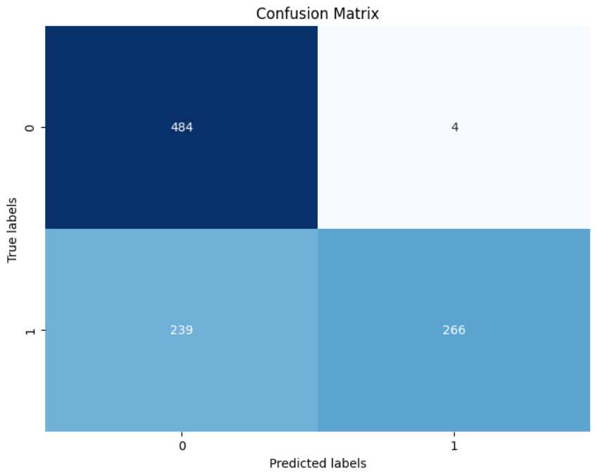
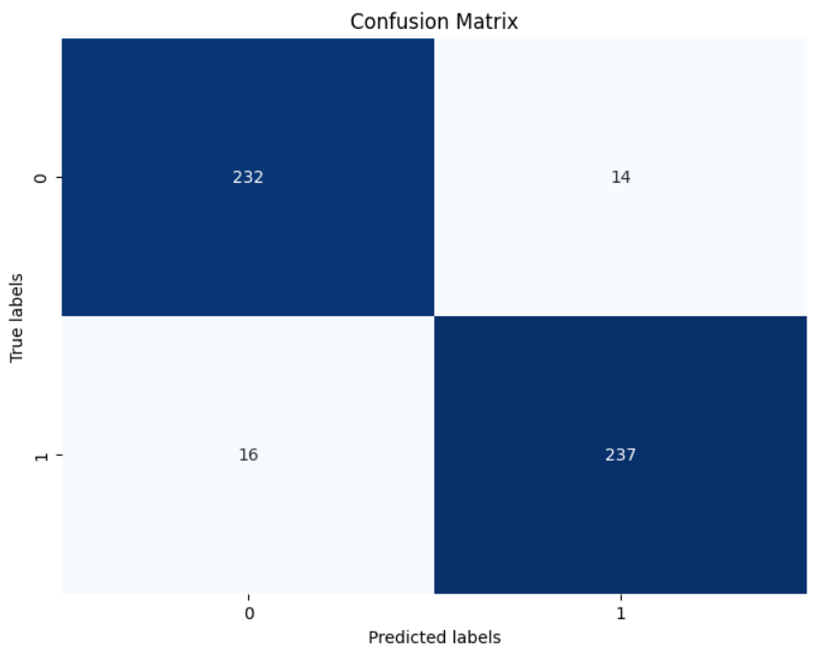
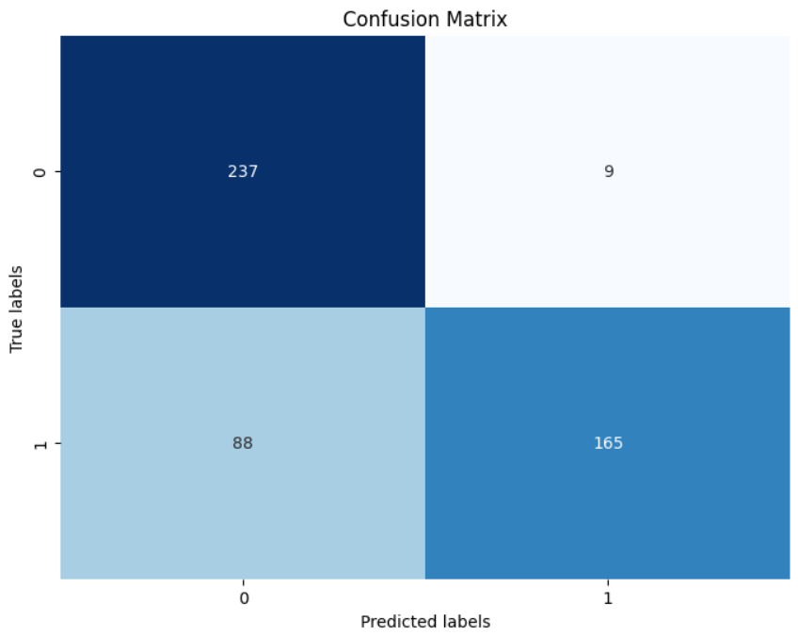
CONFUSION MATRIX USING TENSORFLOW
VGG16 | LENET | ALEXNET

Slide 15
RESULTS WITH PYTORCH
ARCHITECTURE | ACCURACY | PRECISION | RECALL
VGG16 | 90.53 | 92.90 | 87.51
LENET | 77.75 | 76.47 | 78.52
ALEXNET | 78.97 | 72.58 | 90.60

Slide 16
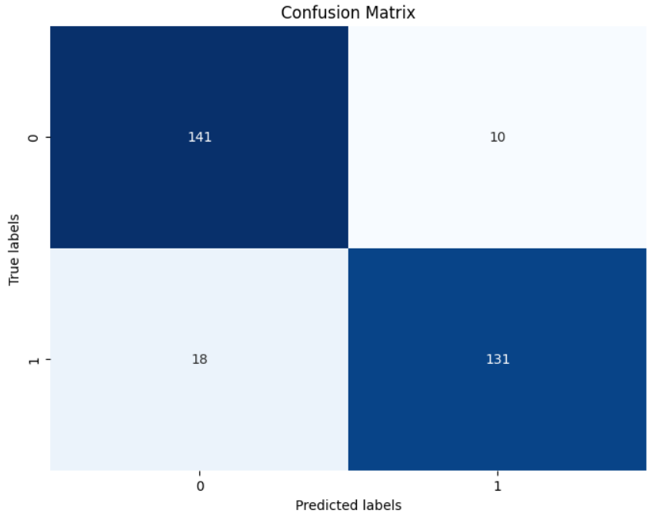
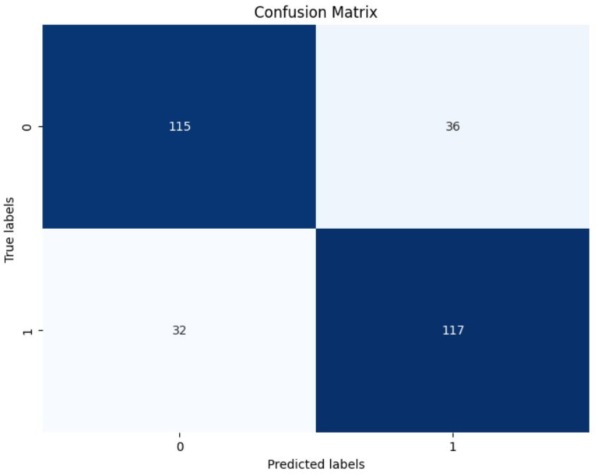
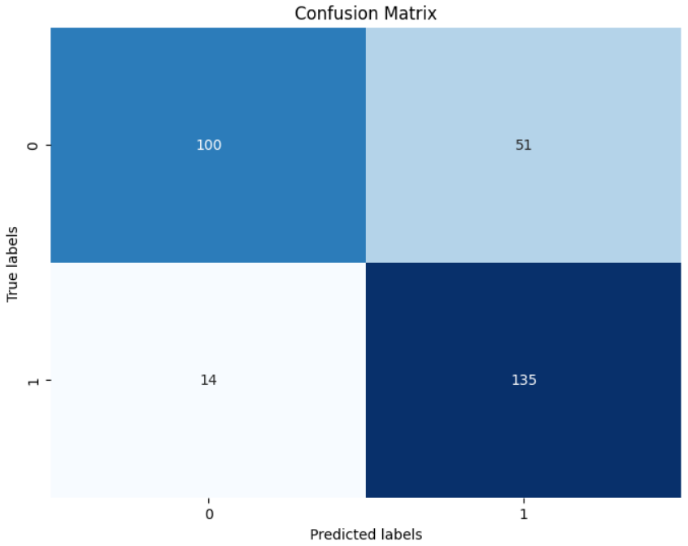
CONFUSION MATRIX USING PYTORCH
VGG16 | LENET | ALEXNET

Slide 17
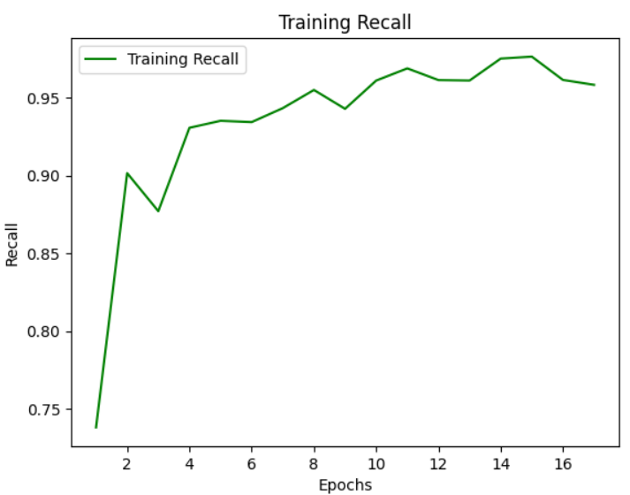
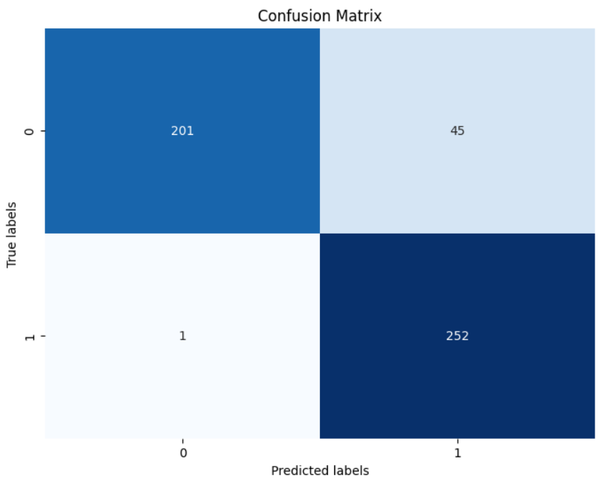
RESULTS WITH EARLY STOPPING
STABLE MODEL – ALEXNET WITH EARLY STOPPING
ACCURACY – 84.72
PRECISON – 84.84
RECALL – 99.6

Slide 18
STABILIZED MODEL
After experimenting with various models a stabilized model was developed using the Alex Net architecture, incorporating early stopping techniques. This model demonstrated exceptional performance by accurately capturing complex patterns in the data, resulting in an impressive accuracy rate of 84 percent and a recall of 96 percent.
The success of the Alex Net-based model underscores the importance of architectural
choices and optimization strategies in achieving superior results in machine learning tasks.

Slide 19
Conclusion
This project has successfully explored and analyzed various deep learning architectures for accurate COVID-19 detection from CT scan images, making significant contributions to the ongoing efforts to combat the pandemic through reliable diagnostic tools.
In conclusion, this project has made a significant contribution to the development of accurate and reliable deep learning-based systems for COVID-19 detection from CT scan images. The findings and methodologies presented in this report can serve as a valuable resource for the research community, healthcare professionals, and policymakers, as they continue to explore and implement innovative approaches to combat this global health crisis. The project's success underscores the critical role that deep learning and AI can play in transforming the future of medical diagnostics and patient care, ultimately contributing to the betterment of human health and well-being.

Slide 20
Future Scope
While this project has made significant strides in advancing the field of deep learning-based COVID-19 detection from CT scans, there are several avenues for future exploration and improvement.
Expanding the Dataset: Gathering and annotating a larger and more diverse dataset of COVID-19 CT scans, including scans from different geographic regions and demographic groups, can further enhance the generalization capabilities of the deep learning models and ensure their applicability in diverse clinical settings.
Multimodal Approaches: Exploring the integration of CT scans with other medical data, such as clinical symptoms, laboratory results, and epidemiological information, can potentially improve the overall diagnostic accuracy and provide a more .

Slide 21
References
Zhen Tian, Peixin Qu, Jielin Li, Yukun Sun, Guohou Li, Zheng Liang, and Weidong Zhang. Analysis of Deep Learning Architectures for Accurate COVID-19 Detection from CT Scan Images. Expert Systems with Applications, 204:117699, 2022. , JOURNAL NAME – Experts Systems with Applications, PUBLISHED YEAR – 2022.
Pranjal Tripathi, Kiran Khatter, Arpan Kumar Kar, and Anirban Mukhopadhyay. A novel deep learning-based approach for COVID-19 detection from chest X-ray images. Measurement, 185:110074, 2022., JOURNAL NAME - Measurement , PUBLISHED YEAR – 2022.
Mehdi Ammi, Hadi Sadoghi Yazdi, and Sahar Mojarad. Robust deep learning-based COVID-19 detection from chest X-ray images using a capsule network. Optics & Laser Technology, 148:107700, 2022., JOURNAL NAME - Optics & Laser Technology, PUBLISHED YEAR - 2022

